Slide 1

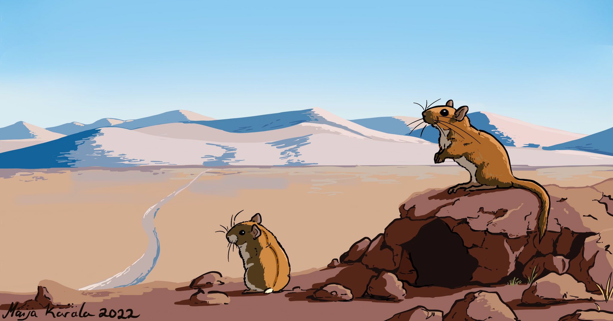
Advancing Energetic Modelling in Wildlife Populations

Slide 2
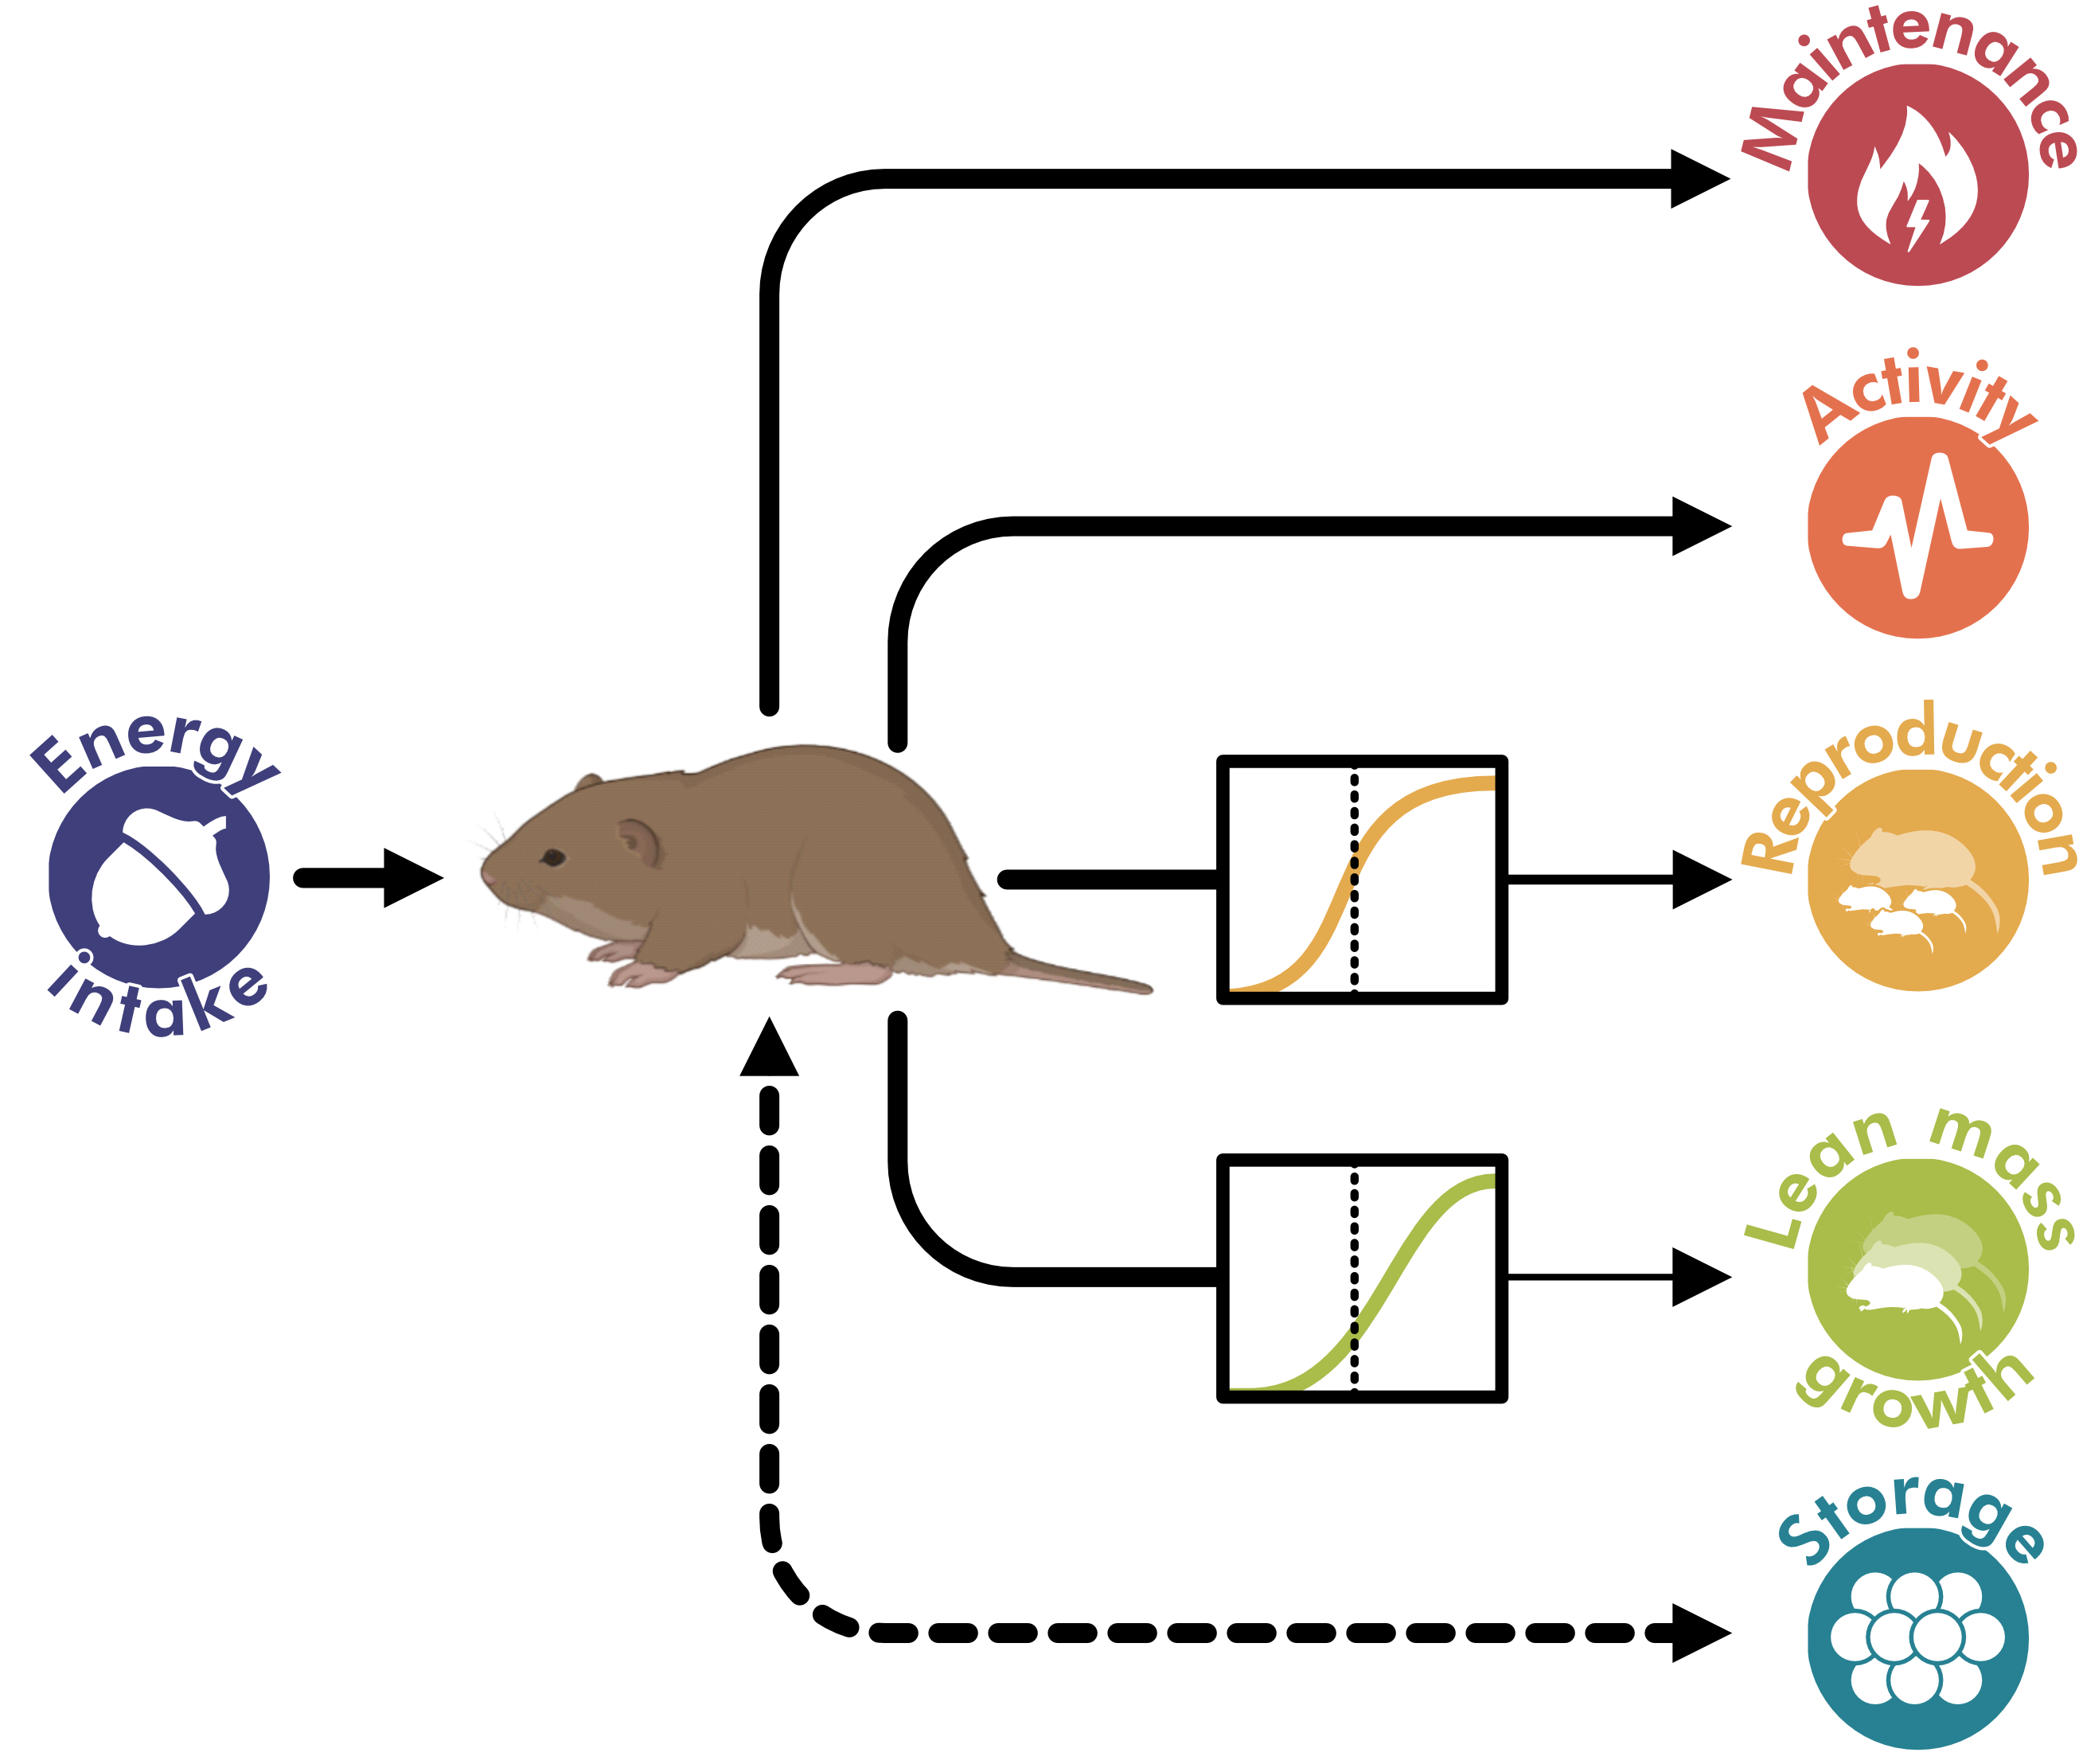
Develop model
framework
Parameterize and evaluate using available vole data
Apply to theoretical scenarios

Slide 3
Goals of first paper
Describe the modelling framework
Development process, comparison to other approaches, key benefits & assumptions, & use cases
Present an example case study
Run scenarios to demonstrate potential applications of the model, should be clear and not too complex

Slide 4
First case study
Demonstrate that the model can be used to:
1) gain a mechanistic understanding of the emergence of individual trait variation, and
2) predict the impacts of environmental change on population dynamics and persistence
Inputs to vary:
Maximum resources cells can contain, regrowth rates, temporal dynamics
Outputs to observe:
1) Individual trait variation in e.g., interbirth interval, body size, body fat, offspring mass at birth, offspring mass at weaning, litter size at weaning, lifetime reproductive success, activity patterns?
2) Population growth rates, stability, and persistence

Slide 5
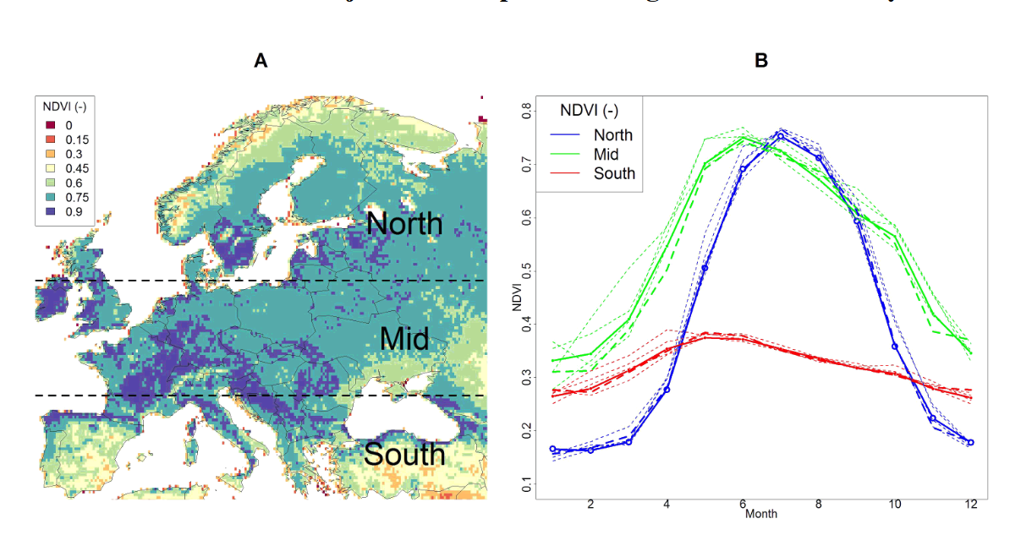
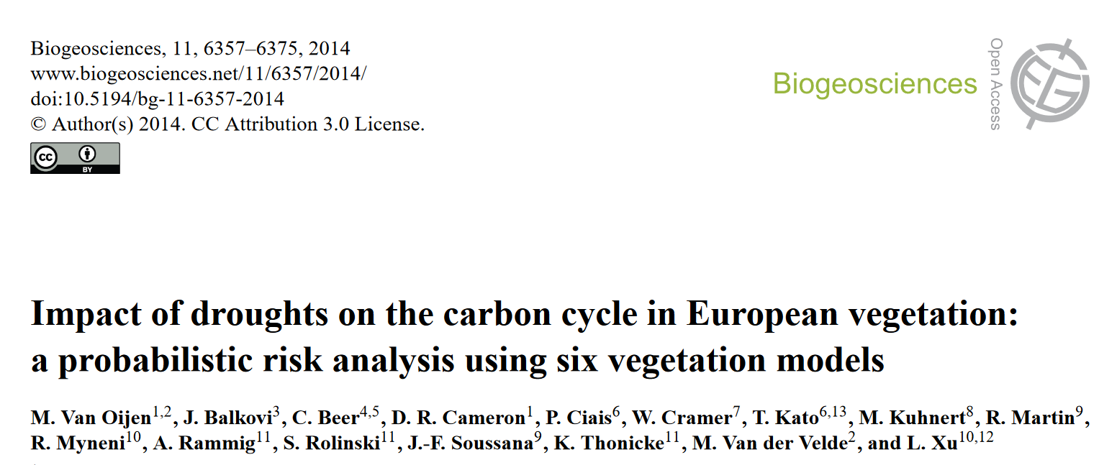
First case study
NDVI – ”current”

Slide 6
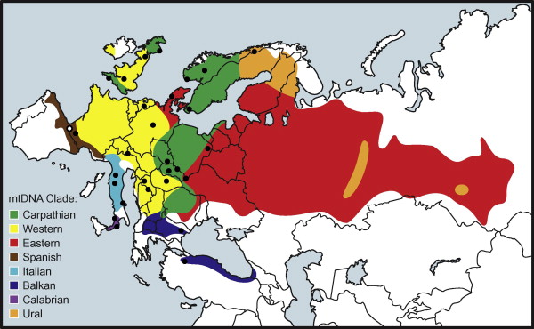
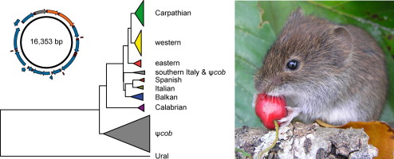
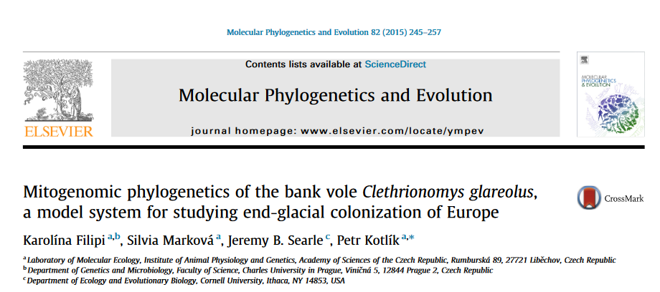
First case study

Slide 7



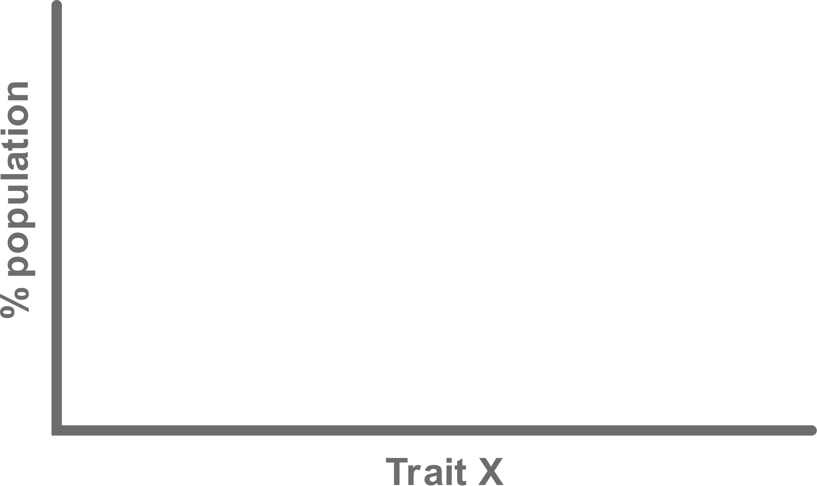

First case study
population growth rates, stability, and persistence

Slide 8
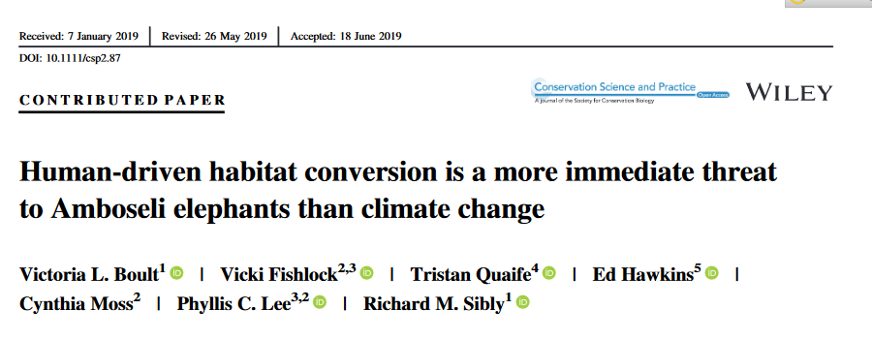
First case study
NDVI – future?
Historic biomass values (2000–2016) were obtained for
the area available to elephants…. Biomass was estimated using NDVI from the Terra-MODIS (Didan, 2015) mission. For each SPI class (very wet, wet, normal, dry, and drought), we calculated a median biomass value per month for each area available to elephants. These values were used to construct monthly biomass time series for the projected period (2007–2099)….

Slide 9
First case study
Focus on extreme events?
population growth rates, stability, and persistence

Slide 10
First case study
If taking this approach, which parameters does it make the most sense to affect: max resources, resource accumulation rate, or actual amount of resources?

